Slide 1

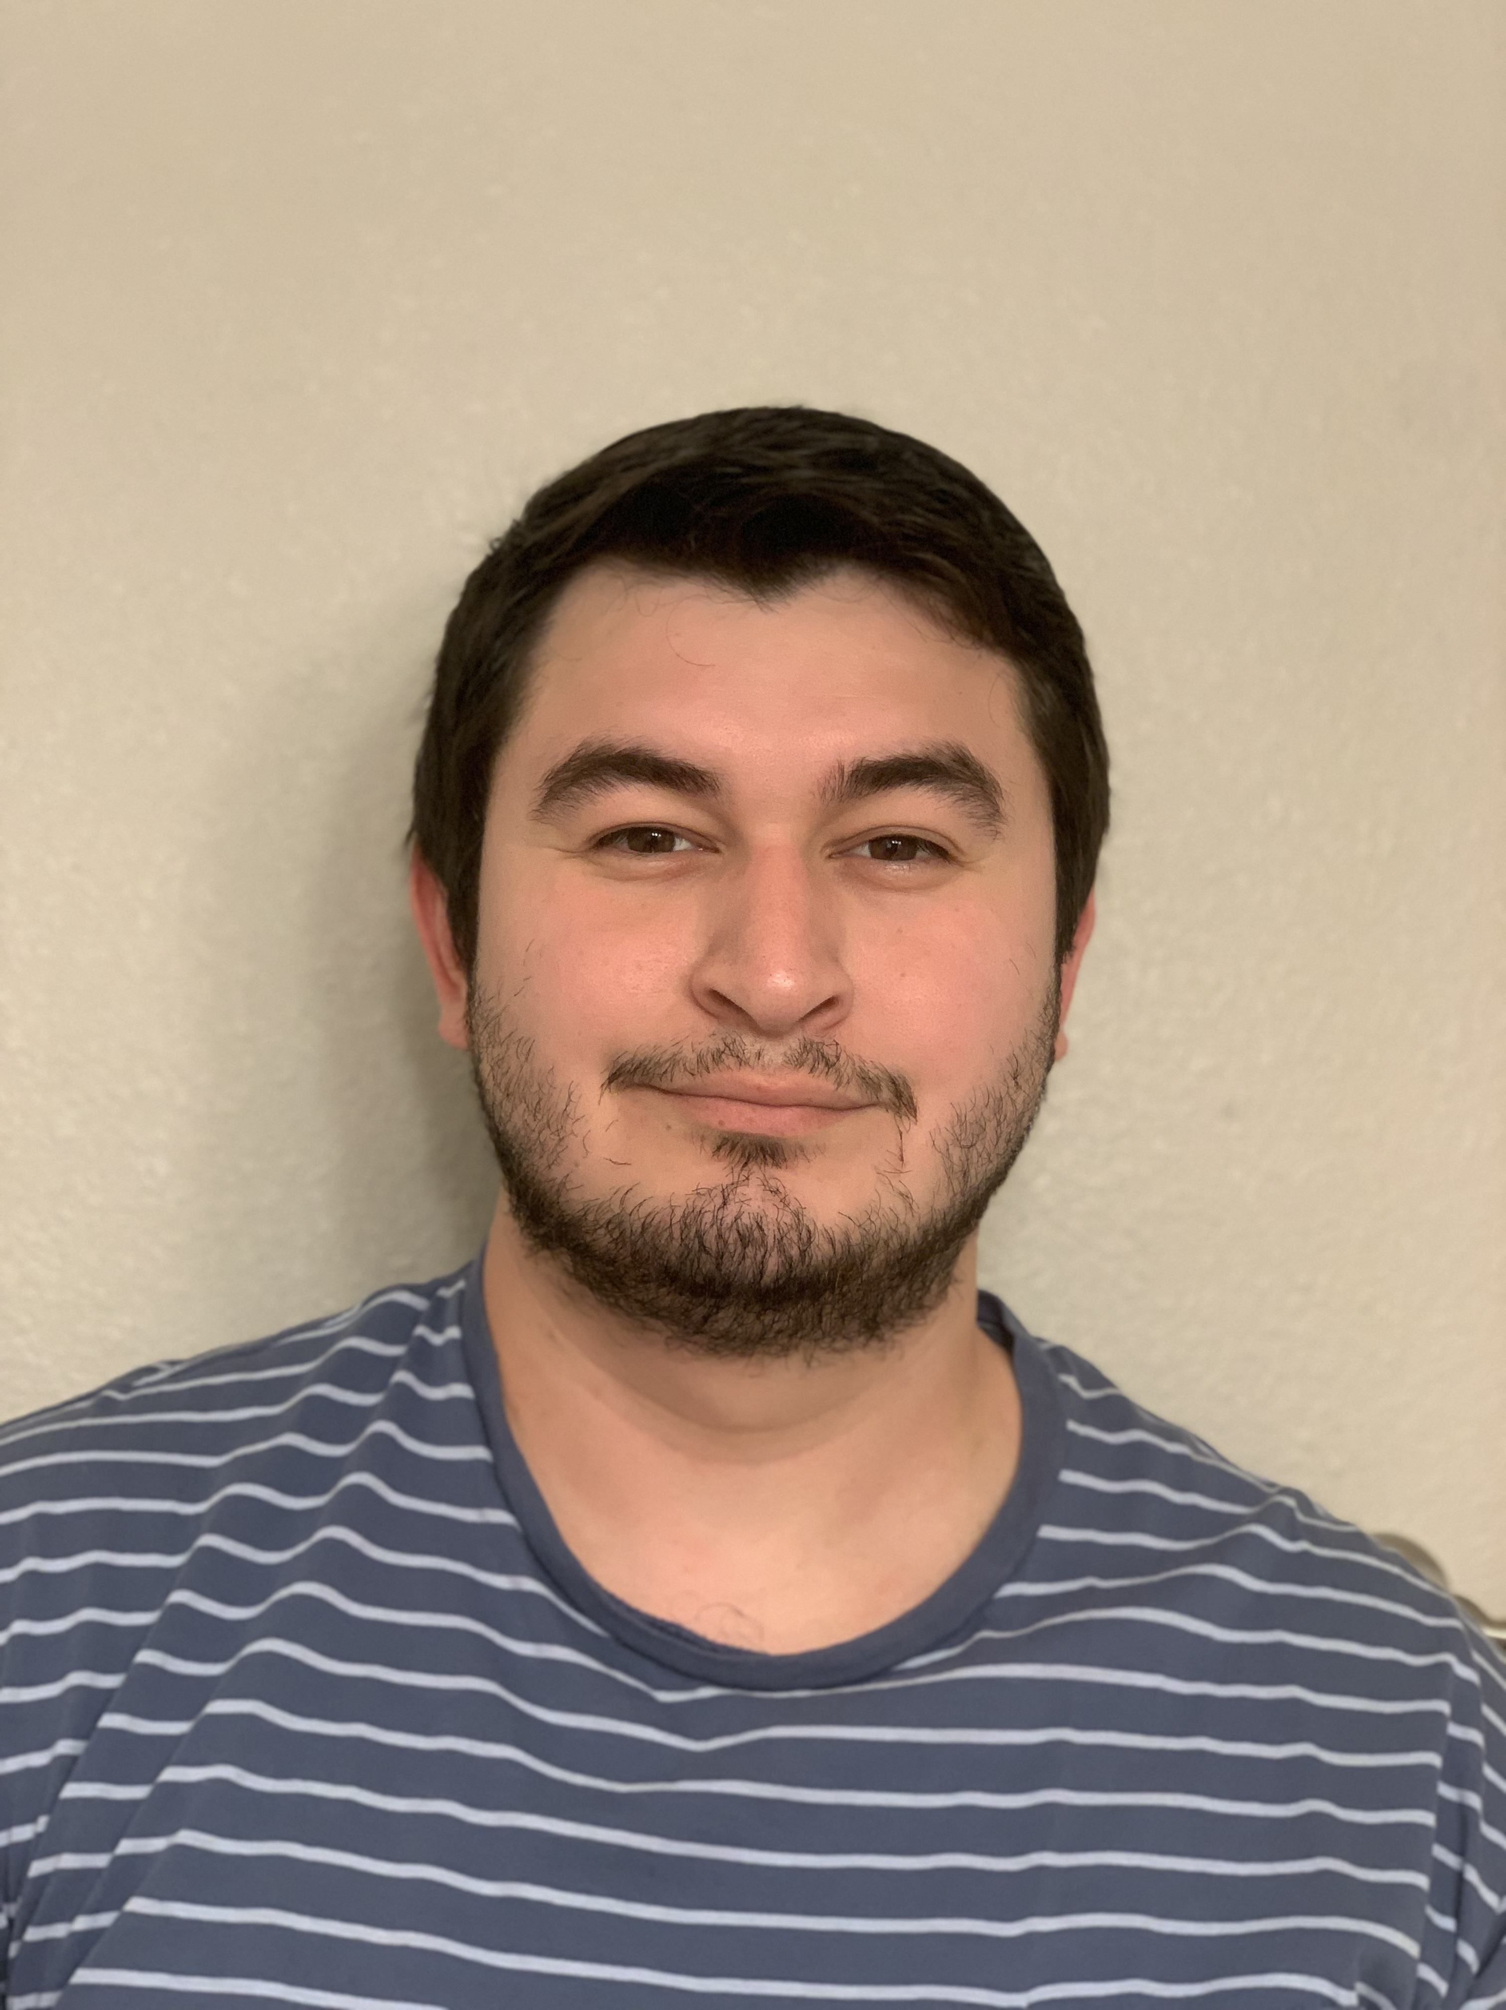
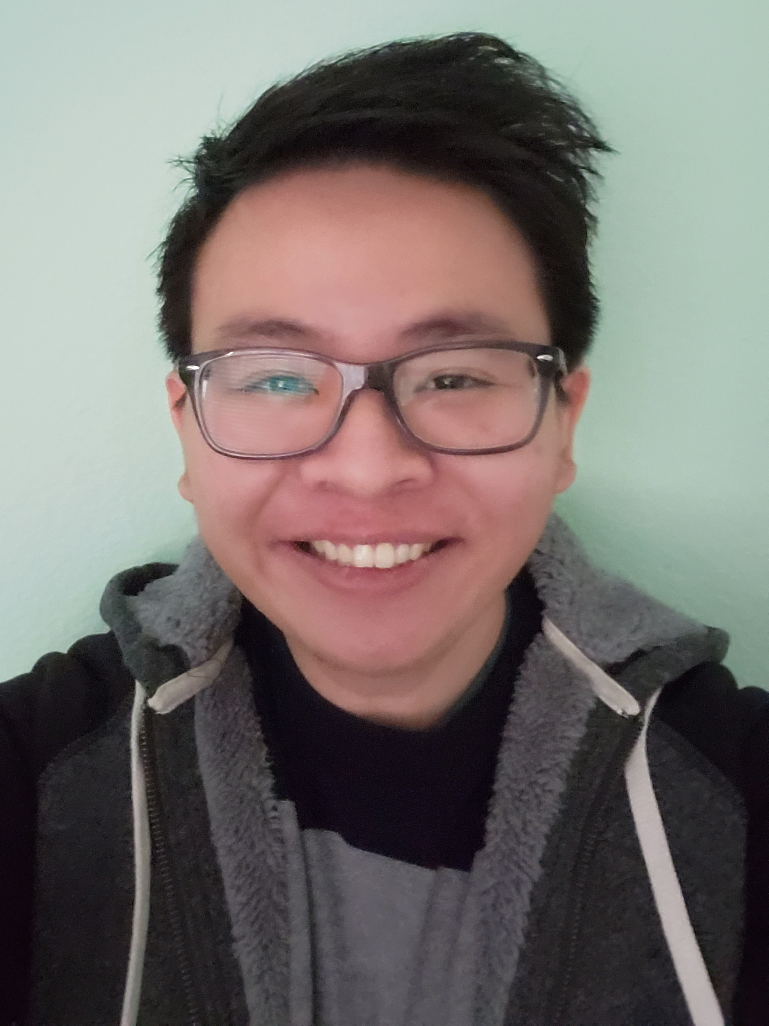
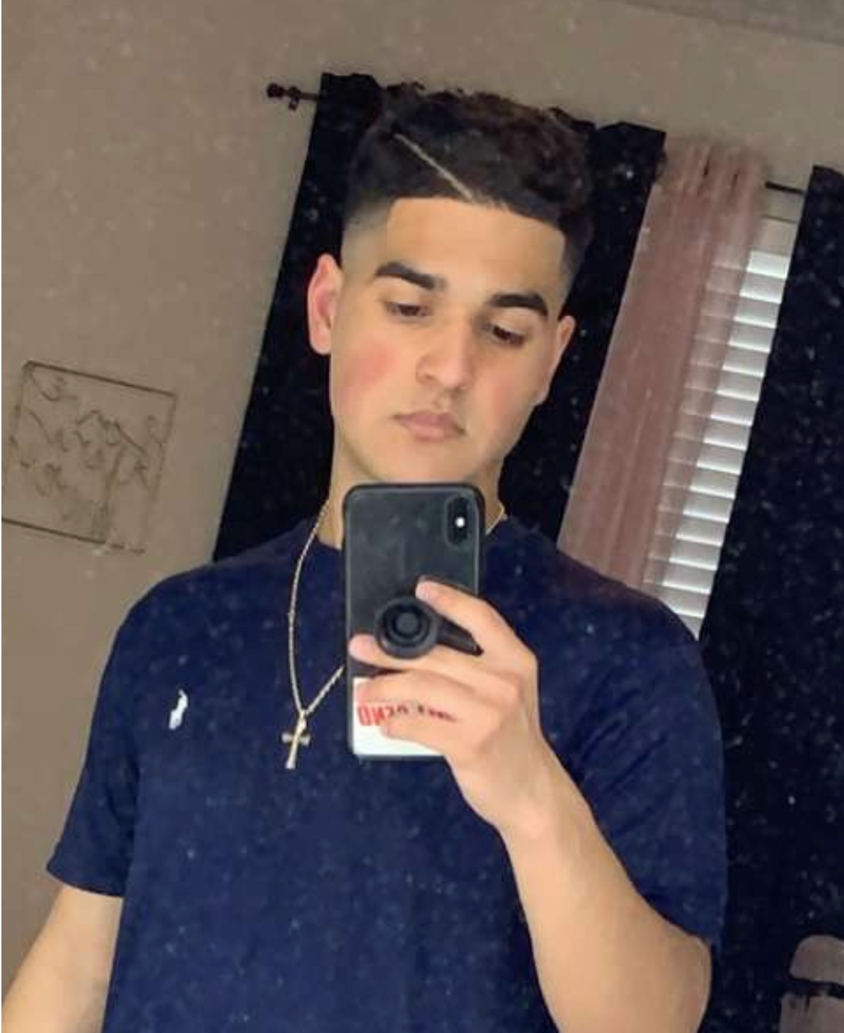

Food Watch
UTSA CS 3443 - 003
Spring 2022
(The Crew)
Lead
Daniel Nevius
dnevius1
Antonio Maldonado
Awaleh Houssein
awalehdek
Peter Banh
Pbramen
Marco Maldonado
marcmal2

Slide 2
Food Watch
Description
Takes in grocery list as user input. Tracks quality of the grocery items and lets user know when they are about to expire. Tracks monthly expenditure on food and provides recipe book.
Pitch
You will save money on items that would otherwise expire. Recipes for all your favorite food. Everyone from home users to culinary businesses would find the product useful.
UTSA CS 3443 - 003
The Crew – Food Watch

Slide 3
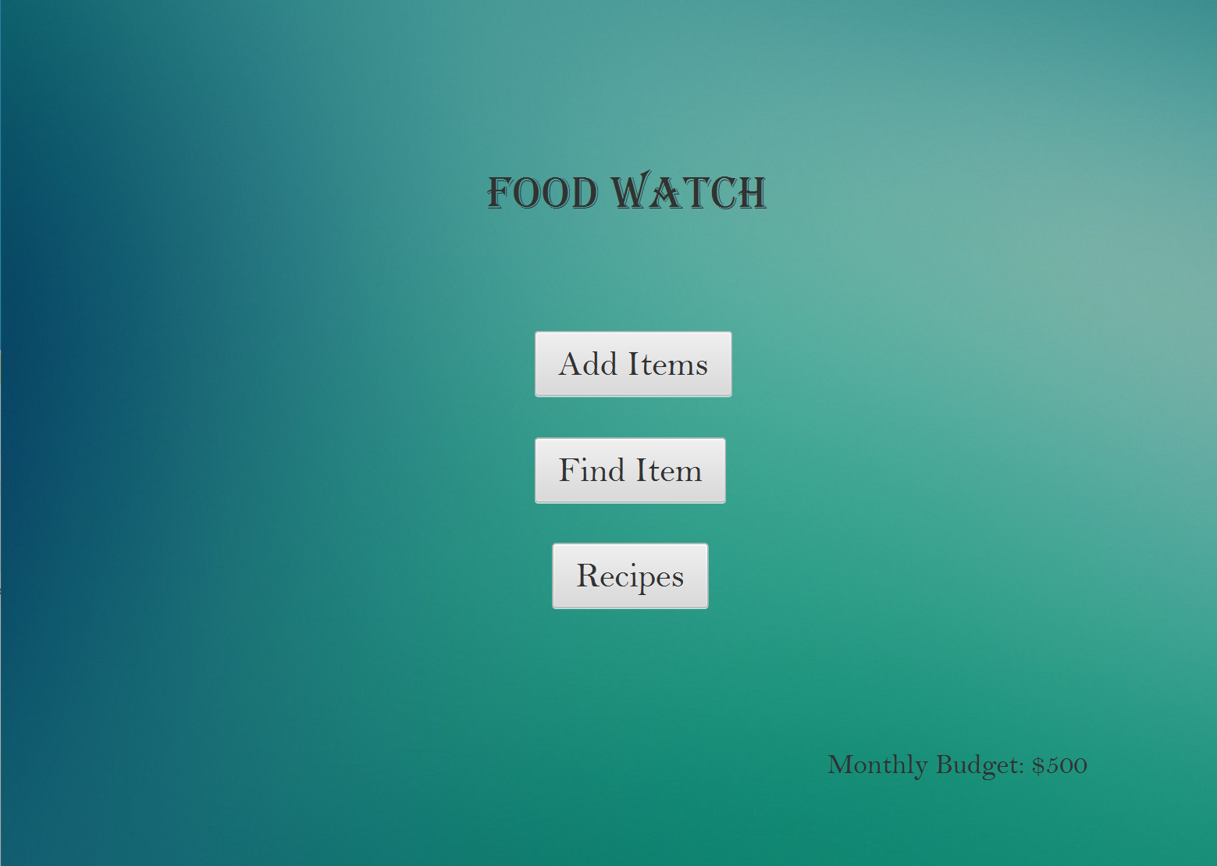
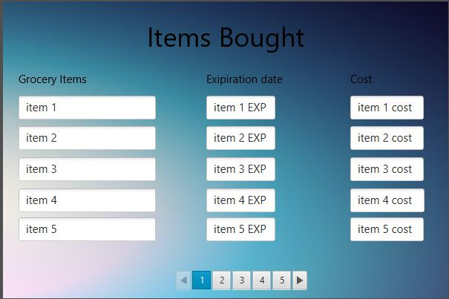
User Interface Design
Main menu
Inputing new items
UTSA CS 3443 - 003
The Crew – Food Watch

Slide 4
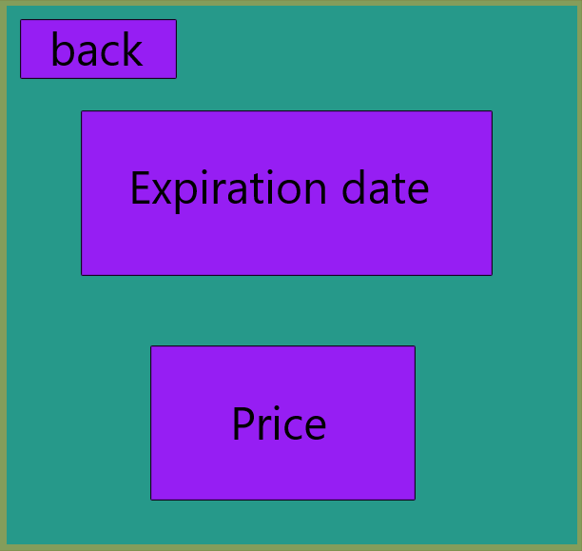
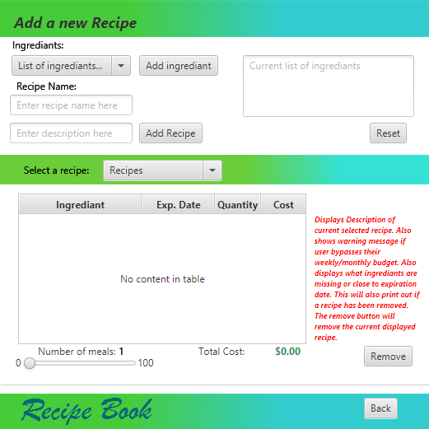
User Interface Design
View single item
Recipe book
UTSA CS 3443 - 003
The Crew – Food Watch

